Slide 1

Solving Complex Data load Challenges
Sunand P
Lead Engineer
spadmanabhan@gainsight.com
Somasekhar Bobba
Director Of Engineering
sbobba@gainsight.com

Slide 2
Safe Harbor
Safe harbor statement under the Private Securities Litigation Reform Act of 1995:
This presentation may contain forward-looking statements that involve risks, uncertainties, and assumptions. If any such uncertainties materialize or if any of the assumptions proves incorrect, the results of salesforce.com, inc. could differ materially from the results expressed or implied by the forward-looking statements we make. All statements other than statements of historical fact could be deemed forward-looking, including any projections of product or service availability, subscriber growth, earnings, revenues, or other financial items and any statements regarding strategies or plans of management for future operations, statements of belief, any statements concerning new, planned, or upgraded services or technology developments and customer contracts or use of our services.
The risks and uncertainties referred to above include – but are not limited to – risks associated with developing and delivering new functionality for our service, new products and services, our new business model, our past operating losses, possible fluctuations in our operating results and rate of growth, interruptions or delays in our Web hosting, breach of our security measures, the outcome of any litigation, risks associated with completed and any possible mergers and acquisitions, the immature market in which we operate, our relatively limited operating history, our ability to expand, retain, and motivate our employees and manage our growth, new releases of our service and successful customer deployment, our limited history reselling non-salesforce.com products, and utilization and selling to larger enterprise customers. Further information on potential factors that could affect the financial results of salesforce.com, inc. is included in our annual report on Form 10-K for the most recent fiscal year and in our quarterly report on Form 10-Q for the most recent fiscal quarter. These documents and others containing important disclosures are available on the SEC Filings section of the Investor Information section of our Web site.
Any unreleased services or features referenced in this or other presentations, press releases or public statements are not currently available and may not be delivered on time or at all. Customers who purchase our services should make the purchase decisions based upon features that are currently available. Salesforce.com, inc. assumes no obligation and does not intend to update these forward-looking statements.
Notes:
Key Takeaway: We are a publicly traded company. Please make your buying decisions only on the products commercially available from Salesforce.com.
Talk Track:
Before I begin, just a quick note that when considering future developments, whether by us or with any other solution provider, you should always base your purchasing decisions on what is currently available.

Slide 3
Agenda
Who are we?
Data Load Challenges
Use Case
Build Your Own Dataloader (BYODL)
Demo
Q&A

Slide 4
About Gainsight
Gainsight
---------------
Cloud Expo
N1007
Our Mission: Grow Revenue Faster with Customer Success
100% Native Force.com App
Extensible via our own Matrix Data Analytics Platform on Heroku
100+ Global Customers managing $20B+ accounts
1
2
3
Increase retention
Drive up/cross-sell
Boost Team
Productivity

Slide 5
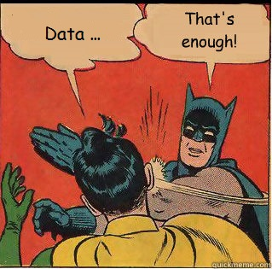
What Are Data Load Challenges
Master-Detail Relationship
Dynamic/Static
Test Data
Data Migration
Lookup
High Volume Data
Data Cleansing
Duplicate Records
Data Purge

Slide 6
Salesforce API’s to Rescue
Salesforce Api
REST API
SOAP API
Chatter REST API
Bulk API
Metadata API
Streaming API
Apex REST API
Apex SOAP API
Tooling API

Slide 7




Case 1
Data Complexity
Has Data > 10K
Has Custom Fields
Has Data with Relationships
Salesforce Admin
External File System
User Story: As a Salesforce User I want to load the Opportunities CSV file from an external system in to my Salesforce Org.

Slide 8

Detailed View
Org 2
Record Id Challenge
New Field Creation
How to Automate
Org 1
Org 3
001SomethinOrg2
001SomethinOrg1
001SomethinOrg3
Salesforce Generated Unique ID
Opportunities
Account
External File
(Opportunity.csv)
AccountID
Lookup
Account Name
Close Date
Opportunity Name
Opportunity Owner
Stage
Type
ID
Account Name
Account Number
Account Owner
Account Site
Account Source
Annual Revenue
Billing Address
Industry
Ownership
Parent Account
Phone
Shipping Address
Type
ID
Account Name
Amount
Close Date
Created By
Expected Revenue
Lead Source
Next Step
Opportunity Name
Opportunity Owner
Probability (%)
Quantity
Stage
Type
Account_Name
Booking_Date
Closed_Date
Subscription_Start_Date
Subscription_End_Date
ASV
OTR
Name
Owner
Stage
Type
UserCount
Fiscal_Year
Account_Name
Closed_Date
Name
Owner
Stage
Type
Lookup
Salesforce Admin

Slide 9



When 2 Engineers Meet
Initial Thoughts
Too Many Rows to update. Can we use,
Salesforce Dataloader
Any ETL Tools.
Account name in Opportunity Csv File
should be replaced with SFDC generated ID
Pull Account data
From Salesforce
External File System
Account.csv
Opportunity.csv
Merge the CSV file having any Field which is Unique.
Salesforce Admin
Salesforce Admin
Push the Result back
to Salesforce

Slide 10
Initial Thoughts Explained
Account Object
Opportunity File
Final Opportunity File
AccountId | Name | StageName | Amount | Type | CloseDate | OTR__c | ASV__c | Users__c
001G000001Cmo38IAB | Opp1 | Closed Won | 220000 | New Customer | 2011-06-26 | 10 | 20 | 30
001G000001Cmo39IAB | Opp2 | Closed Won | 220000 | New Customer | 2011-06-26 | 10 | 20 | 30
001G000001Cmo3AIAR | Opp3 | Closed Won | 220000 | New Customer | 2011-06-26 | 10 | 20 | 30
001G000001Cmo3BIAR | Opp4 | Closed Won | 220000 | New Customer | 2011-06-26 | 10 | 20 | 30
Id | Name
001G000001Cmo38IAB | TEAC Corp. of America
001G000001Cmo39IAB | Ziff-Davis Labs
001G000001Cmo3AIAR | Purity-Supreme Inc.
001G000001Cmo3BIAR | IBIS Systems Inc.
Id | Name
001G000001Cmo38IAB | TEAC Corp. of America
001G000001Cmo39IAB | Ziff-Davis Labs
001G000001Cmo3AIAR | Purity-Supreme Inc.
001G000001Cmo3BIAR | IBIS Systems Inc.
AccountName | Name | StageName | Amount | Close Date | Type | OTR__c | ASV__c | Users__c
TEAC Corp. of America | Opp1 | Closed Won | 220000 | 2011-06-26 | New Customer | 10 | 20 | 30
Ziff-Davis Labs | Opp2 | Closed Won | 220000 | 2011-06-26 | New Customer | 10 | 20 | 30
Purity-Supreme Inc. | Opp3 | Closed Won | 220000 | 2011-06-26 | New Customer | 10 | 20 | 30
IBIS Systems Inc. | Opp4 | Closed Won | 220000 | 2011-06-26 | New Customer | 10 | 20 | 30
AccountName | Name | StageName | Amount | Close Date | Type | OTR__c | ASV__c | Users__c
TEAC Corp. of America | Opp1 | Closed Won | 220000 | 2011-06-26 | New Customer | 10 | 20 | 30
Ziff-Davis Labs | Opp2 | Closed Won | 220000 | 2011-06-26 | New Customer | 10 | 20 | 30
Purity-Supreme Inc. | Opp3 | Closed Won | 220000 | 2011-06-26 | New Customer | 10 | 20 | 30
IBIS Systems Inc. | Opp4 | Closed Won | 220000 | 2011-06-26 | New Customer | 10 | 20 | 30

Slide 11


BYODL Using Salesforce API’s
API
Pre-Processing
Extract
Transform
Load
CSV to DB
H2
Column Join
Metadata API
Salesforce Bulk API
Salesforce Bulk API
Bulk API
Data Merge
Bulk API
Create Fields
Embedded DB
DB
Load
Related Data
Pull
Push
Transform
Your Own Dataloader

Slide 12
ETL Job Config
"transform": {
"query" : “Input Direct SQL Query Here",
"useQuery" : false,
"limit" : 100,
"tableInfo": [
{
"file": "./resources/datagen/process/account.csv",
"table": "account",
"joinColumnName": "name",
"columns": [
{ "name": "Id",
"alias": "AccountId"
}]
},
{
"file": "./testdata/sfdcdata/opp/Opportunity.csv",
"table": “opportunity",
"joinColumnName": “Account_Name",
"columns": [
{
"name": “Closed_Date",
"alias": “CloseDate"
},
{
"name": “Stage",
"alias": “Stage"
}]
}
],
"join": true,
"output": "./resources/datagen/process/Final_Customers.csv"
},
Sample Json
{
"jobName": "job1",
"namespacePrefix" : “ABC”,
"useNameSpace" : false,
"extract": {
"source": "sfdc",
"connection": "conf/application.conf",
"table": "Account",
"fields": ["Id", "Name"],
"output": "./resources/datagen/process/account.csv"
},
"load": {
"target": "sfdc",
"sObject": “Opportunity__c",
"operation": "insert",
"contentType": "CSV",
"cleanUp" : true,
"file": "./resources/datagen/process/Final_Customers.csv"
}
}

Slide 13
Demo
Case 1

Slide 14
Case 2
Managed Package
V 1.0
Managed Package V 2.0
Upgrade/
Fresh Install
Beta Cycle
Beta3
Beta 2
Beta 1
Beta N
Managed Package
Partner/ISV
Load
Load
Test Data
Test Data
User Story: As a QA Engineer, I want to load Standard Test Data in multiple orgs so that we can save time in test cycles.

Slide 15
Things to look out for
Preparing Test Data
Handle Duplicate Records
Org Configuration
App Settings
Purge and Load Data

Slide 16
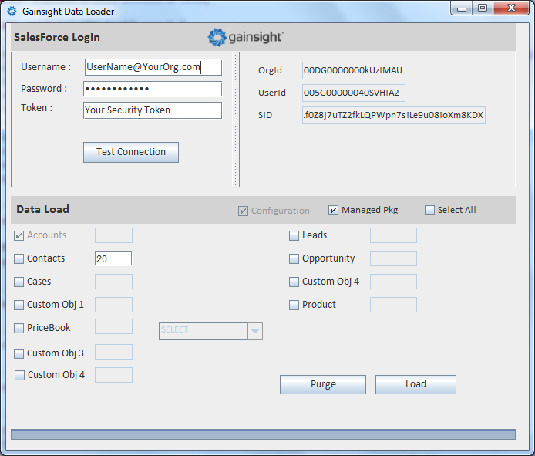
Engineers Meet Again
Extending Initial Thoughts
We need to repeat this for every Release Cycle
Can’t We Extend the approach we discussed earlier?
Prepare Test Data
(Account.csv, opportunity.csv)
Org Configuration Using Metadata API
Administrative Tasks can be done via Anonymous Apex Code
Create an ETL Config
Run the Job to load Data in to Salesforce
Salesforce Admin
Salesforce Admin

Slide 17
Demo
Case 2

Slide 18

Wrapping Up
Purge Data
Query Salesforce Record ID and Do Bulk Delete for Data > 10K (Using Bulk Api)
External ID
Loading test data again & again we need to UPSERT records to avoid Duplicates.
We can refer External ID in CSV file header and perform bulk UPSERT operation.
Metadata API
Records < 10K can be deleted by Using SOQL query with Apex.
Bulk API
Data with higher volumes should use Bulk API for both Import/Export. Since Salesforce has provided excellent ways to fire Async calls and monitor the same.
Administrative Settings for App like enabling an option or trying to generate data for functional tests can done via Apex API.
Apex API
Configurations like Remote Site Setting, Assigning a Permission Set to an User can be done via Metadata API.
Custom Objects + Custom Fields can be created using Metadata API.
Embedded DB
Use InMemory DB to perform SQL Joins outside salesforce.
Do transformations and prepare end CSV file as per Salesforce needs.
Take Away

Slide 19
Helpful Links
Code Share → https://github.com/sunand85/DF14_Demo
Apex Developer Guide → https://www.salesforce.com/us/developer/docs/apexcode/
Metadata Developer Guide → https://www.salesforce.com/us/developer/docs/api_meta/
H2 DB → http://www.h2database.com/h2.pdf
External Id → http://blog.jeffdouglas.com/2010/05/07/using-exernal-id-fields-in-salesforce/
Salesforce Record Id Prefix Decoder → https://help.salesforce.com/apex/HTViewSolution?id=000005995&language=en_US

